Slide 1
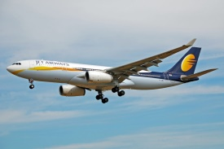
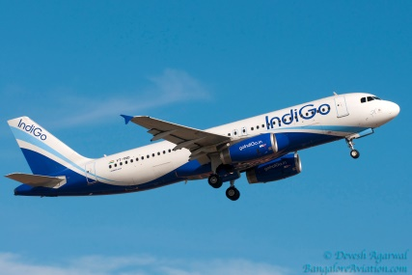
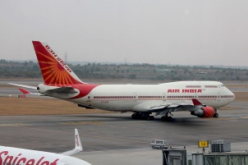
Flights Price Prediction Model
Presented by:-
Sahib Hussain
Internship 17

Slide 2
Problem Statement
With the Covid 19 impact in the market, we have seen lot of changes in the travel industry. Flights were non-operational during the pandemic which resulted in huge losses to many Airlines Companies and has impacted a lot in the price. With the change in market due to Covid 19 impact, We would be making a model which can help us determine the price of flights taking various features into consideration.

Slide 3
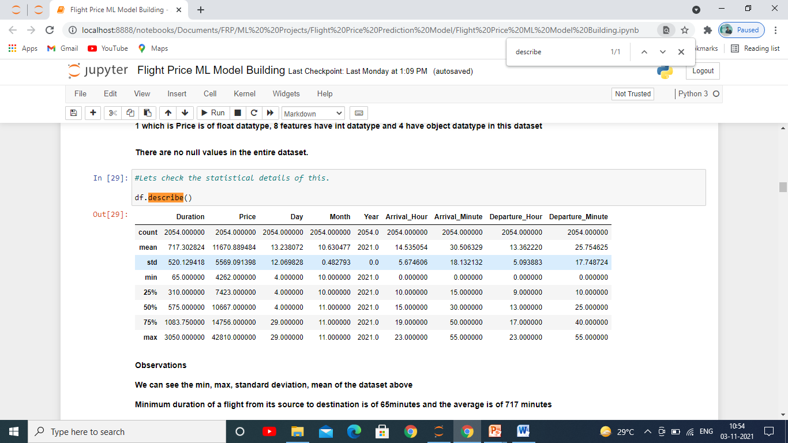
Dataset Statistics
We can see that Minimum duration of a flight from its source to destination is of 65minutes and the average is of 717 minutes.
Minimum fare is of 4262 rupees and the maximum is of 42810 depending upon the source and destination of the flight and the average price is of 11670 rupees.
Arrival average is 1430 hours whereas the average departure time is 1325 hours.

Slide 4
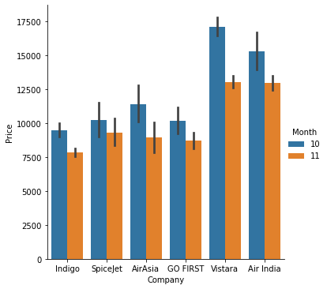
Prices of Various Airlines Companies
Vistara has the highest number of flights for the month of October whereas Indigo has least.
For the month of November Air India and Vistara have same number of flights while the least is of Indigo.
Price are decreasing with increase in date of flight which means there is negative linear relation between price and date of flights

Slide 5
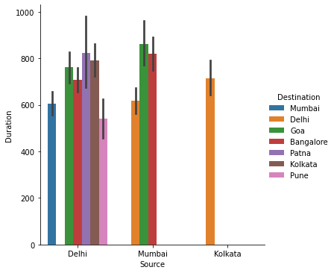
Duration between source and destination
Flight Duration between Mumbai to Goa is highest whereas for Delhi to Pune the duration is least.
Number of flights operating from Delhi is highest whereas from Kolkata the flights are only for one destination which is Delhi.

Slide 6
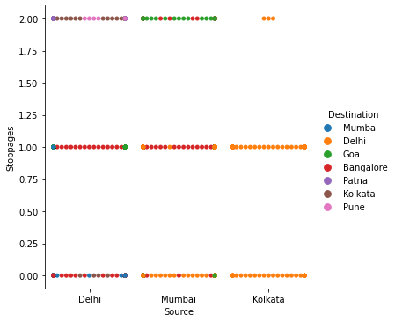
Stoppages between Source and Destination.
Flight route between Mumbai to Goa has highest number of stoppages on an average.
Least number of stoppages is in the route Mumbai to Delhi on an average.
Flights from Delhi are mostly for Bangalore and have either no stop or 1 stop but not more than that, more than 1 stoppages from Delhi for flights are for destination Kolkata and Pune.
From Mumbai are majorly for three destinations which are Delhi, Bangalore, Goa and have 2 or more than 2 stoppages mostly for Goa and Bangalore but less
Flights from Kolkata are for Delhi and have all types of stoppage but less for two or more than two stoppages

Slide 7
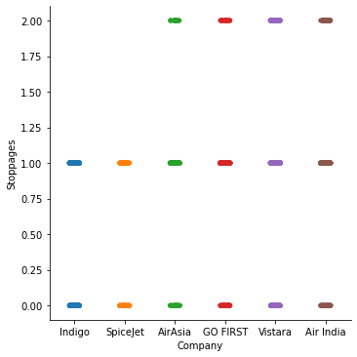
Stoppages by Various Airline Companies
Indigo and Spice Jet are the companies which have the least number of stoppages in between source and destination mostly without or just 1 stoppages.
All other companies have all three types of stoppages between Source and Destination.

Slide 8
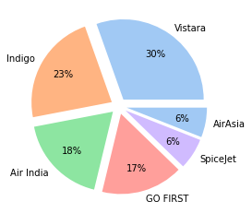
Number of Flights operating by Companies
Pie chart is clearly indicating that flights operating are most of Vistara company and least of Air Asia and Spice Jet.

Slide 9
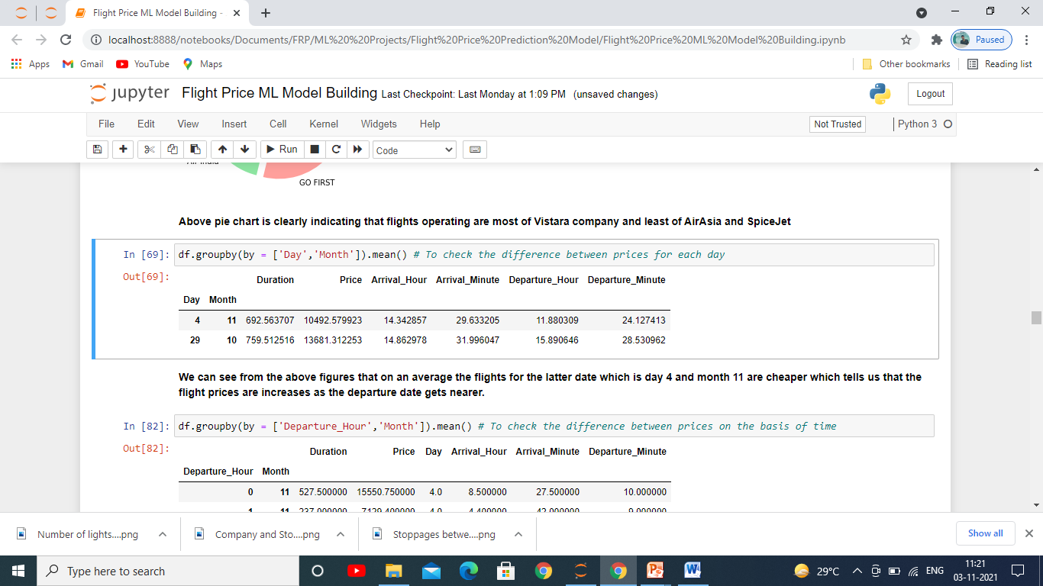
Effect of date on Prices
We can see from the above figures that on an average the flights for the latter date which is day 4 and month 11 are cheaper which tells us that the flight prices are increases as the departure date gets nearer.

Slide 10
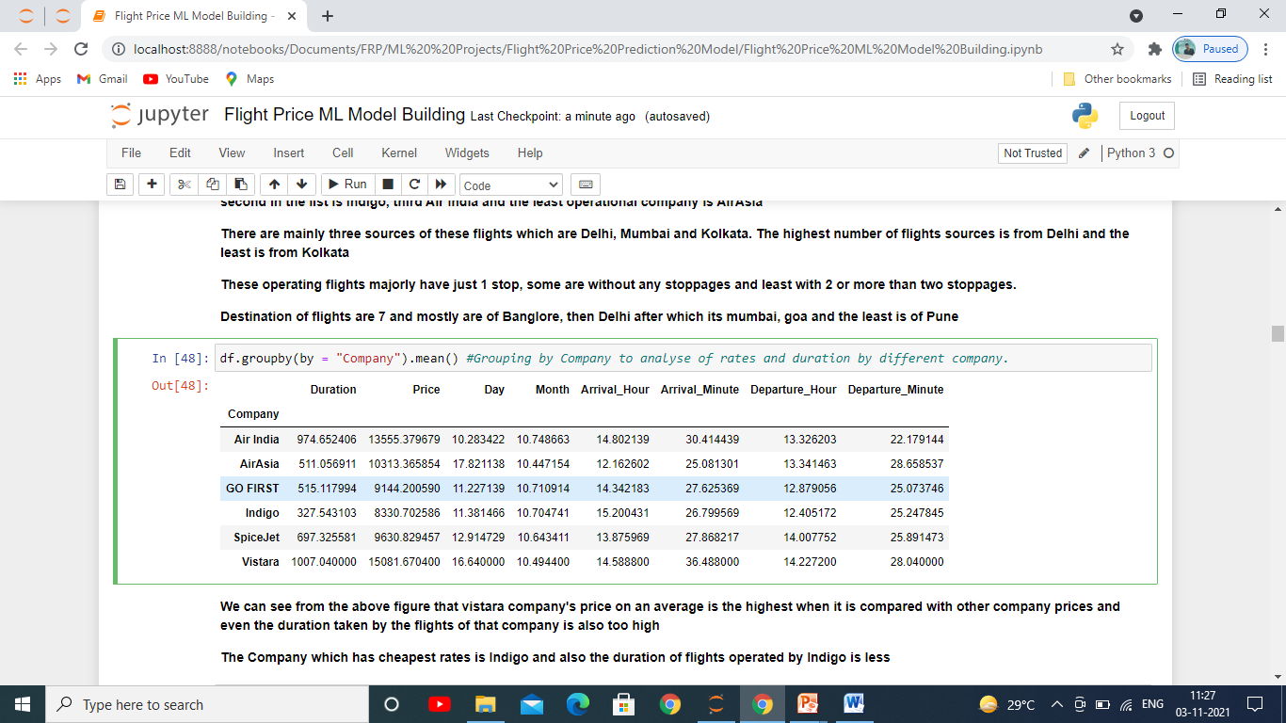
Average Price by Companies
We can see from the above figure that Vistara company's price on an average is the highest when it is compared with other company prices and even the duration taken by the flights of that company is also too high.
The Company which has cheapest rates is Indigo and also the duration of flights operated by Indigo is less.

Slide 11
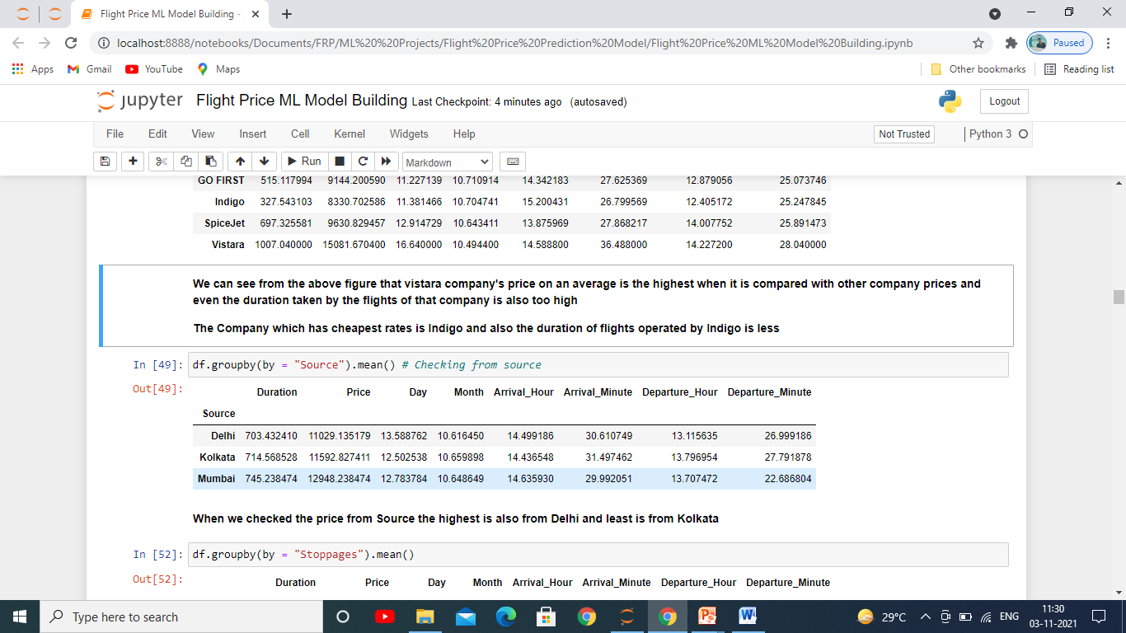
Average Price From Source
When we checked the price from Source the highest is also from Delhi and least is from Kolkata.

Slide 12
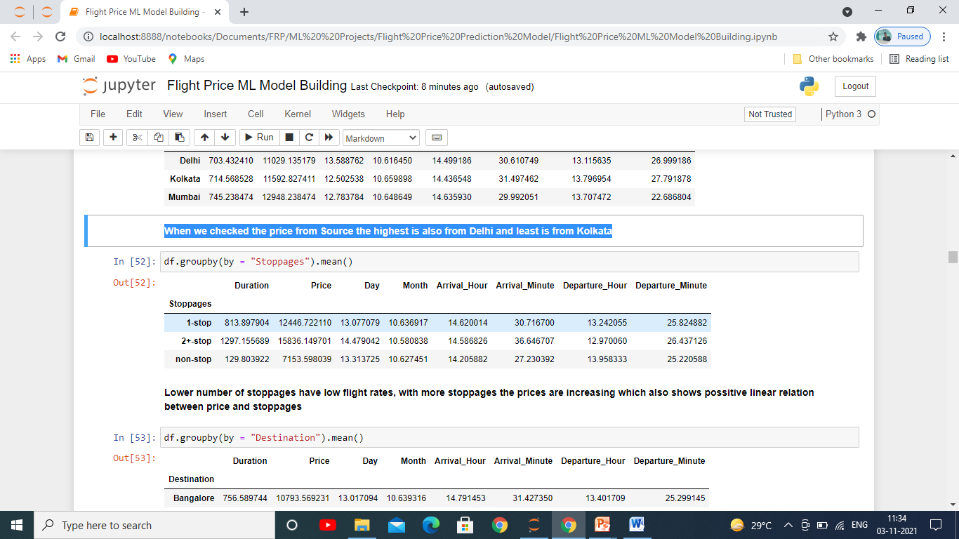
Effects Of Stoppages On Price
Lower number of stoppages have low flight rates, with more stoppages the prices are increasing which also shows positive linear relation between price and stoppages.

Slide 13
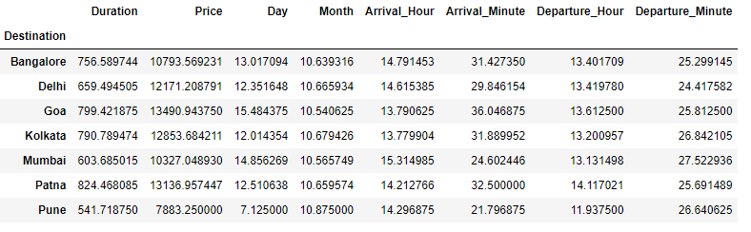
Effect Of Destinations On Prices
The flight fares for Pune destination is least and duration is also least among all destination whereas for Goa the price is highest among all other cities.

Slide 14
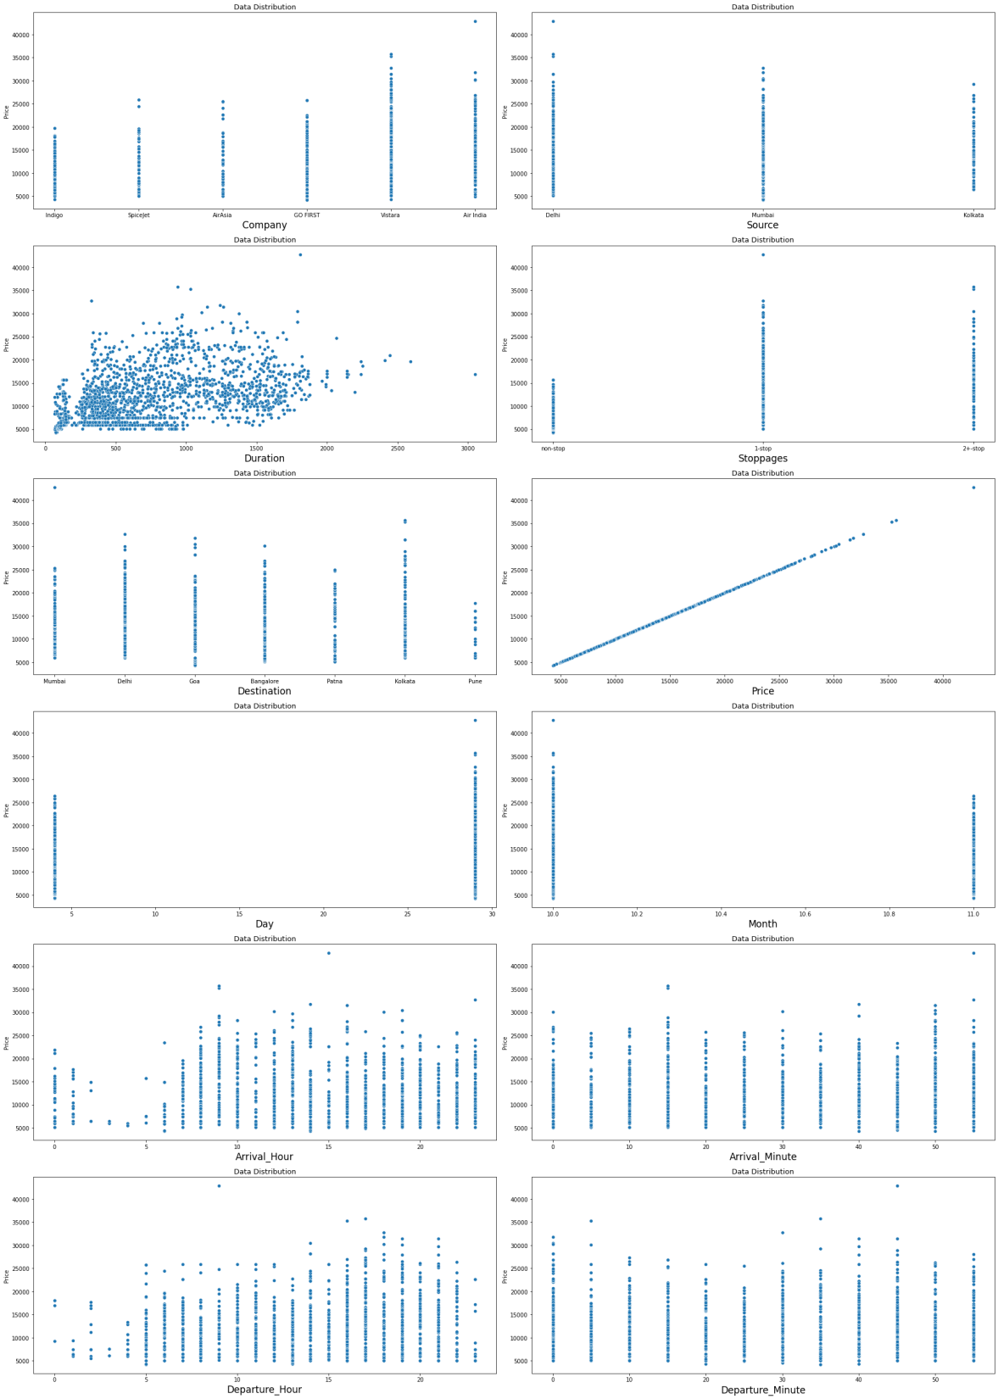
Checking Data Distribution of Our Dataset
Above figure is showing some positive linear relation between Duration and Price, Stoppages and Price, Departure_Hour and Price, and Negative relation between Month and Price.

Slide 15
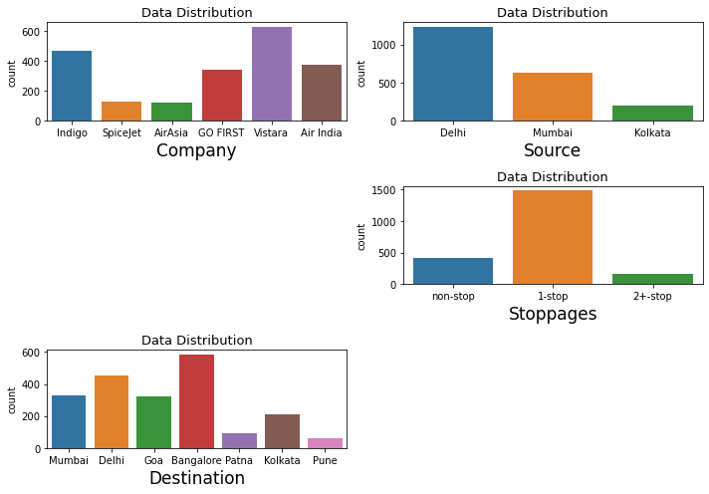
Categorical Independent Variables
In Company feature as we can see above that there are 6 companies which are operating there flights and flights are mostly of Vistara company, second in the list is Indigo, third Air India and the least operational company is Air Asia.
There are mainly three sources of these flights which are Delhi, Mumbai and Kolkata. The highest number of flights sources is from Delhi and the least is from Kolkata.
These operating flights majorly have just 1 stop, some are without any stoppages and least with 2 or more than two stoppages.
Destination of flights are 7 and mostly are of Bangalore, then Delhi after which its Mumbai, Goa and the least is of Pune.

Slide 16
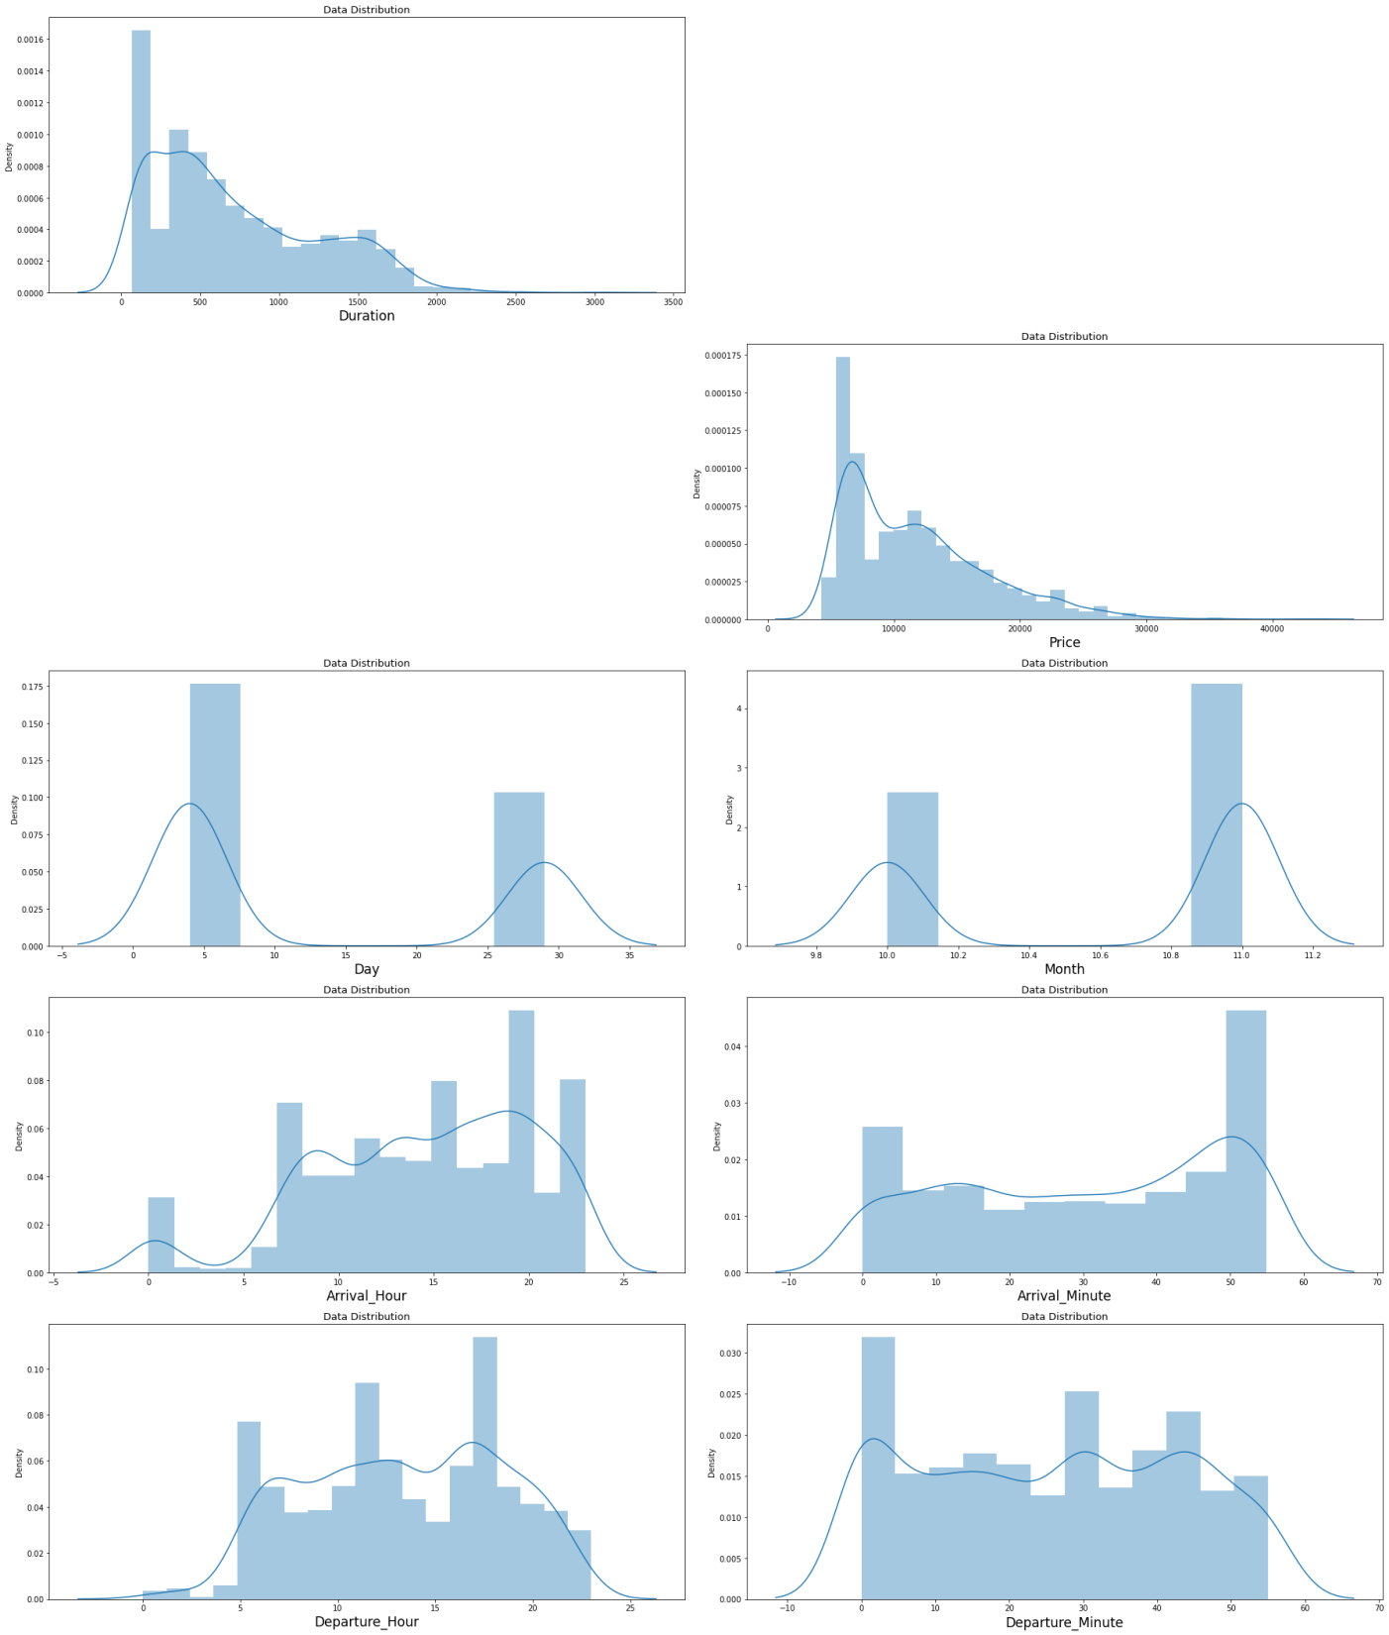
Skewness In the Dataset
There was a bit Skewness in the feature Duration, rest of the data is looking fine.

Slide 17
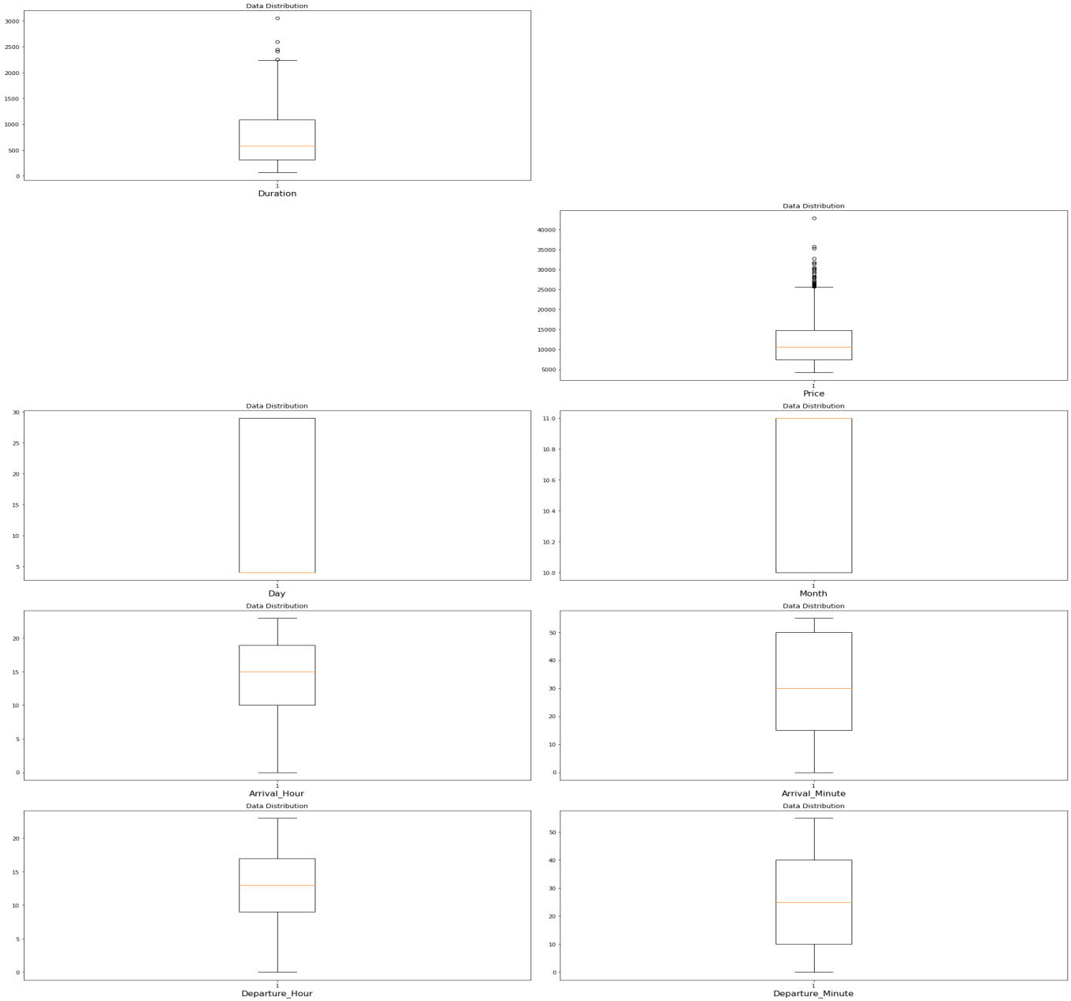
Outliers In the Dataset
Only Duration feature had some outliers in it.

Slide 18
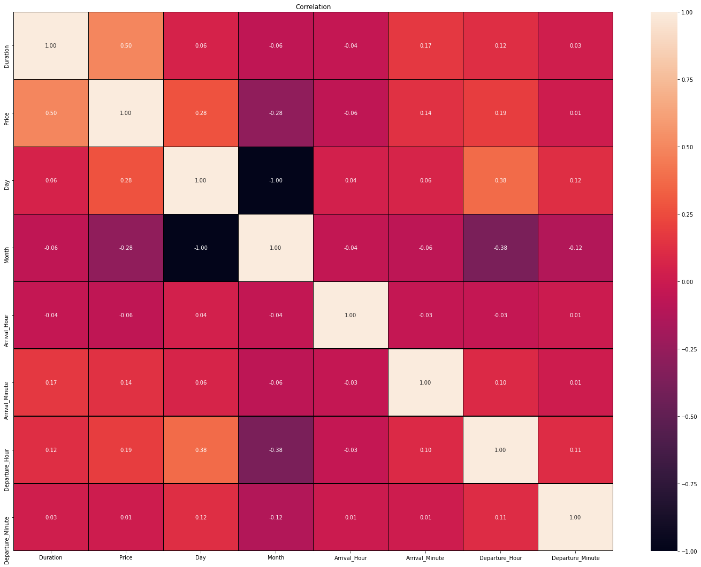
Co-linearity Among Features
There is hardly any co-relation amongst the features.

Slide 19
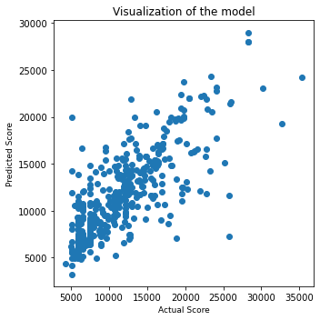
Model Predictions Plot
This image is showing us the relation between our predicted values and actual values as we can see that there is not much gap between predicted and actual datapoints for Xtreme Gradient Boost Regressor which shows that it is best fit for our dataset. Also we saw the scores for other 4 algorithms however XGB Regressor had delivered us the best scores among them

Slide 20
Conclusion
In this project we found how various factors can hugely impact the price of Flights. A little bit of change in the Timings of booking, departure hour and destination can drastically bring change to it’s price. How important the features are in determining the price of flights.

